Slide 1
Predicting IMDB ratings of new movies
Presented by
Mehana
Kavi Priya
Harini
Priya Dharshini
Srimathi

Slide 2
Introduction
Predicting IMDb scores using data science involves analyzing various features of movies, such as genre, director, cast, budget, and user reviews, to build a predictive model.
Techniques like regression analysis, machine learning algorithms (such as linear regression, decision trees, or neural networks), and feature engineering are commonly used in this process .
To start, you would need a dataset containing relevant information about movies and their IMDb scores. After collecting and cleaning the data, you can split it into training and testing sets.
Then, you can choose an appropriate machine learning algorithm, train the model on the training data, and evaluate its performance using the testing data . Feature selection and engineering play a crucial role in improving the accuracy of the prediction.
For example, you can create new features like average user rating, analyze sentiment from user reviews, or categorize movies into different genres or budget ranges .
Regular validation and fine-tuning of the model are necessary to ensure its accuracy and relevance. It's also essential to handle missing data and outliers effectively to prevent bias in the predictions .
Remember that the success of predicting IMDb scores depends on the quality and quantity of the data, as well as the choice of the right algorithm and feature engineering techniques.

Slide 3


Slide 4
1.Data collection
There are several sources where you can find datasets for predicting IMDb scores using data science techniques. Here are a few suggestions:
1. *IMDb Datasets:* IMDb provides various datasets for non-commercial use. You can access datasets containing information about movies, actors, directors, ratings, and more. Visit the IMDb datasets page to find the data you need: [IMDb datasets](https://www.imdb.com/interfaces/)
2. *Kaggle:* Kaggle is a platform for data science competitions and hosts a wide range of datasets, including those related to movies and entertainment. You can search for movie-related datasets on Kaggle: [Kaggle datasets](https://www.kaggle.com/datasets)
3. *UCI Machine Learning Repository:* UCI offers datasets for machine learning research, and while they might not have a specific IMDb dataset, they have datasets related to movie ratings and reviews: [UCI Machine Learning Repository](http://archive.ics.uci.edu/ml/index.php)
4. *GitHub:* Many researchers and data enthusiasts share datasets on GitHub. You can search for movie-related datasets on GitHub and find repositories containing relevant data.
When using a dataset, make sure to check its details, including the features available (like movie title, genre, director, cast, budget, user reviews, etc.) and the format of the data. Understanding the dataset's structure is crucial for data preprocessing and building accurate prediction models.
Always ensure that you have the right to use the dataset for your intended purpose, especially if you plan to publish or share your analysis publicly. Many datasets come with licenses or terms of use that you need to comply with.

Slide 5
2. Data processing merging , cleaning and filtering
Data processing is a crucial step in predicting IMDb scores using data science techniques. Properly preparing and cleaning the data can significantly impact the accuracy and reliability of your prediction models. Here's how you can approach data processing for this task:
*Data Cleaning:* - Handle Missing Values: Address missing values in the dataset. You can either remove rows with missing values or fill them using techniques like mean, median, or interpolation. - Outlier Detection: Identify and handle outliers in numerical features. Outliers can significantly affect the predictions, so it's essential to detect and appropriately deal with them. - Duplicate Data: Check for and remove any duplicate entries in the dataset to prevent bias in the analysis.
*Feature Selection and Engineering:* - Feature Selection: Identify the most relevant features that can influence IMDb scores. You can use techniques like correlation analysis to understand the relationships between features and the target variable. - Feature Engineering: Create new features that might have a significant impact on IMDb scores. For example, you can calculate the average user rating, create binary variables for movie genres, or categorize directors and actors based on their previous successes.

Slide 6
3. *Data Transformation:* - Categorical Variables: Encode categorical variables into numerical values using techniques like one-hot encoding or label encoding. This step is essential as most machine learning algorithms work with numerical data. - Normalization/Standardization: Scale numerical features to a similar range. Normalization (scaling features to a range of [0, 1]) and standardization (scaling features to have a mean of 0 and a standard deviation of 1) are common techniques. - Text Data (if applicable): If your dataset includes text data like user reviews, you might need to preprocess the text, perform tasks like tokenization, stemming, or sentiment analysis to extract meaningful features. 4. *Data Splitting:* - Split the processed data into training and testing sets. The training set is used to train the machine learning model, while the testing set is used to evaluate its performance. 5. *Validation and Cross-Validation:* - Use techniques like k-fold cross-validation to validate your model. This helps in assessing how well your model performs on different subsets of the data and provides a more reliable evaluation metric. 6. *Monitoring and Iteration:* - Continuously monitor the performance of your model. If the predictions are not as accurate as expected, you might need to revisit the data processing steps, try different algorithms, or engineer new features . By paying careful attention to data processing, you can enhance the accuracy and reliability of your IMDb score prediction models.

Slide 7
4.Libraries
When predicting IMDb scores using data science, you can utilize various Python libraries for tasks such as data manipulation, visualization, and machine learning. Here are some essential libraries and how you can download them:
1. *Pandas:* - *Description:* Pandas is a powerful library for data manipulation and analysis. It provides data structures like data frames and tools for cleaning and preprocessing data. - *Installation:* You can install Pandas using pip in your command prompt or terminal: pip install pandas
2. *NumPy:* - *Description:* NumPy is a library for numerical computations in Python. It provides support for large, multi-dimensional arrays and matrices, as well as a large collection of high-level mathematical functions to operate on these arrays. - *Installation:* NumPy can be installed via pip: pip install numpy
3. *Matplotlib and Seaborn:* - *Description:* Matplotlib is a popular data visualization library, and Seaborn is built on top of Matplotlib and provides a high-level interface for drawing attractive and informative statistical graphics. - *Installation:* You can install both libraries using pip:
pip install matplotlib seaborn

Slide 8
4. *Scikit-Learn:* - *Description:* Scikit-Learn is a machine learning library that provides simple and efficient tools for data mining and data analysis. It includes various algorithms for regression, classification, clustering, and more. - *Installation:* Scikit-Learn can be installed via pip: pip install scikit-learn 5. *Natural Language Toolkit (NLTK) - for Text Data (if applicable):* - *Description:* NLTK is a powerful library for natural language processing (NLP). It provides tools for processing and analyzing text data, including tokenization, stemming, and sentiment analysis. - *Installation:* You can install NLTK using pip: pip install nltk 6. *XG Boost - for Advanced Machine Learning (optional):* - *Description:* XG Boost is an optimized gradient boosting library designed for speed and performance. It is particularly useful for improving the accuracy of machine learning models. - *Installation:* You can install XG Boost using pip: pip install xg boost Remember, these libraries can be installed using the command line or terminal of your operating system. Make sure you have Python installed on your system before attempting to install these libraries. You can check your Python installation by typing python --version in the command prompt or terminal.

Slide 9
5.Training and testing
Certainly! Here's a step-by-step guide on how to train and test a machine learning model for predicting IMDb scores using data science techniques:
### Step 1: Data Preparation
1. *Load Data:* Import your dataset containing features (movie genre, director, cast, budget, etc.) and IMDb scores.
2. *Data Cleaning:* Handle missing values, outliers, and duplicates in your dataset.
3. *Feature Engineering:* Create new features if necessary and convert categorical variables into numerical representations (e.g., using one-hot encoding).
4. *Split Data:* Divide your data into features (X) and the target variable (y), where X contains the features, and y contains IMDb scores.
### Step 2: Splitting Data into Training and Testing Sets python from sk learn . model _ selection import train _ test _ split# Split the data into features (X) and target variable (y)X = ... # Feature sy = ... # IMDb scores# Split the data into training and testing sets (e.g., 80% training, 20% testing)X _ train, X _test, y _t rain, y _ test = train _test _ split(X, y, test _ size=0.2, random _ state=42)
### Step 3: Choosing a Model Choose an appropriate regression algorithm based on your problem. For instance, you can use Linear Regression, Decision Trees, Random Forest, or Gradient Boosting Regressor.
### Step 4: Training the Model python from sk learn . linear_ model import Linear Regression # Create a regression model (for example, Linear Regression)model = Linear Regression()# Train the model using the training data model . fit(X _ train, y _train)

Slide 10
### Step 5: Making Predictions python # Make predictions on the test data predictions = model . predict(X _ test). ### Step 6: Evaluating the Model python from sk learn .metrics import mean _ squared _ error, r2_score # Calculate Mean Squared Error (MSE) mse = mean _ squared _ error(y _ test, predictions)print(“Mean Squared Error (MSE):", mse) # Calculate R-squared scorer2 = r2_score(y _ test, predictions)print("R-squared Score:", r2). ### Step 7: Fine-Tuning and Optimization Depending on the performance of your model, you might need to fine-tune hyperparameters, try different algorithms, or perform feature selection/engineering for optimization. You can also use techniques like cross-validation for a more robust evaluation. ### Additional Tips:- *Feature Scaling:* If you're using algorithms sensitive to feature scales (like Linear Regression), consider normalizing or standardizing your features. - *Cross-Validation:* Use techniques like k-fold cross-validation to assess your model's performance across different subsets of the data. - *Regularization:* If you're using linear regression and facing overfitting issues, consider adding regularization techniques like Lasso or Ridge regression . Remember, the choice of the model and the evaluation metrics depends on the specific characteristics of your dataset and the problem you're trying to solve. Experimentation and iteration are key to finding the best-performing model.

Slide 11
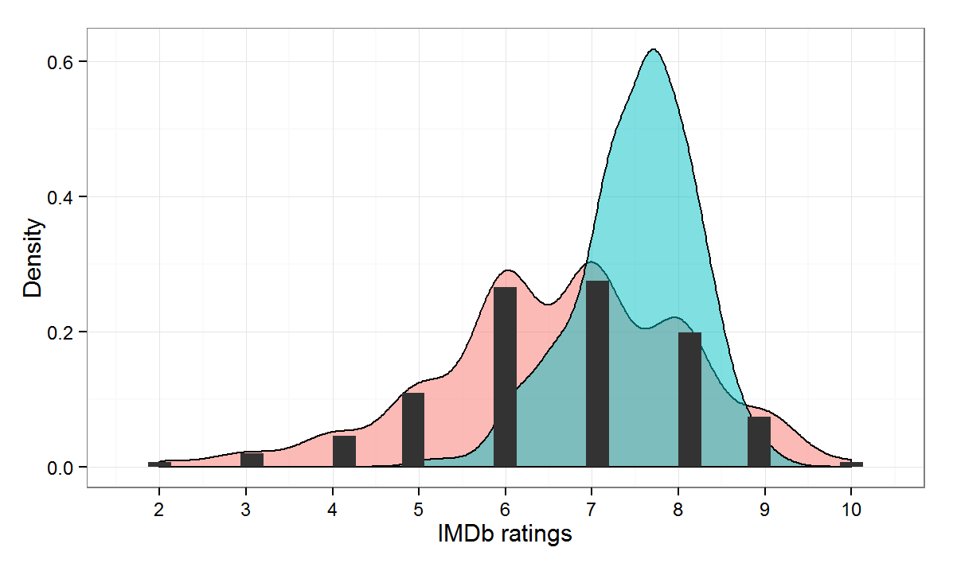

Slide 12
6.Rest of explanation
Certainly, let's continue with the explanation on predicting IMDb scores using data science:
### Step 8: Interpret and Analyze Results Analyze the model's predictions and see which features have the most significant impact on IMDb scores. Visualization tools such as scatter plots or feature importance plots can help in understanding the relationships.
### Step 9: Address Overfitting (if necessary)If your model performs well on the training data but poorly on the test data, it might be overfitting. Consider simplifying your model, gathering more data, or using regularization techniques to prevent overfitting.
### Step 10: Deployment and Monitoring Once you have a satisfactory model, you can deploy it to make predictions for new, unseen data. Continuous monitoring is essential, as the real-world data might change over time. Regularly updating and retraining the model can help maintain its accuracy.
### Additional Considerations:
- *Feature Importance:
* Utilize techniques like feature importance scores from algorithms such as Random Forest or Gradient Boosting to understand which features contribute the most to IMDb scores. This insight can guide your feature selection process.
- *Handling Categorical Data:* If your dataset contains categorical variables (like movie genres), you might consider techniques like one-hot encoding or label encoding to convert them into numerical values that the model can understand.

Slide 13
- *Hyperparameter Tuning:* Experiment with different hyperparameter values for your chosen algorithm. Grid search or randomized search techniques can help you find the best combination of hyperparameters for your model. - *Ensemble Methods:* Explore ensemble methods like Random Forest or Gradient Boosting, which combine predictions from multiple models to improve accuracy and generalization. - *Handling Text Data:* If your dataset includes text data (such as user reviews), you can use natural language processing (NLP) techniques to extract meaningful features. Tokenization, sentiment analysis, or topic modeling can be valuable in understanding textual information. - *Monitoring and Maintenance:* Keep track of your model's performance over time. If its accuracy degrades, you might need to reevaluate your features, collect new data, or update your machine learning algorithm . By following these steps and considering these additional factors, you can create an effective and accurate IMDb score prediction model using data science techniques. Remember that the process might involve iteration and experimentation to find the best approach for your specific dataset and problem.

Slide 14
7.accuracy
When predicting IMDb scores using data science, several metrics can be used to evaluate the accuracy of your prediction model. Here are some commonly used metrics:
1. *Mean Squared Error (MSE):*
- *Definition:* MSE calculates the average of the squared differences between predicted and actual values. It gives more weight to larger errors.
- *Interpretation:* A lower MSE indicates a better fit of the model to the data.
- *Calculation:* \[ MSE = \frac{1}{n} \sum_{i=1}^{n} (y_i - \hat{y_i})^2 \] where \(y_i\) is the actual IMDb score, \(\hat{y_i}\) is the predicted IMDb score, and \(n\) is the number of observations.
2. *Root Mean Squared Error (RMSE):*
- *Definition:* RMSE is the square root of the MSE. It provides the error in the same units as the target variable.
- *Interpretation:* A lower RMSE indicates a better fit of the model.
- *Calculation:* \[ RMSE = \sqrt{MSE} \]
3. *Mean Absolute Error (MAE):*
- *Definition:* MAE calculates the average of the absolute differences between predicted and actual values.
- *Interpretation:* MAE is easy to understand as it represents the average error.

Slide 15
4. *R-squared (R²) Score:* - *Definition:* R² measures the proportion of the variance in the dependent variable (IMDb scores) that is predictable from the independent variables (features) in the model. - *Interpretation:* R² score ranges from 0 to 1. A higher R² indicates a better fit of the model. However, it doesn't indicate whether the model is overfitting. - *Calculation:* It is calculated during model evaluation and represents the proportion of variance explained by the model. 5. *Adjusted R-squared:* - *Definition:* Adjusted R² penalizes the addition of unnecessary predictors to the model. It adjusts the R² score based on the number of predictors in the model. - *Interpretation:* Adjusted R² is useful when comparing models with different numbers of predictors. - *Calculation:* Adjusted R² is calculated using a formula that takes into account both R² and the number of predictors. 6. *Mean Squared Logarithmic Error (MSLE):* - *Definition:* MSLE measures the average of the natural logarithm of the predicted and actual values' squared differences. - *Interpretation:* MSLE is useful when predicting values that span several orders of magnitude. - *Calculation:* \[ MSLE = \frac{1}{n} \sum_{i=1}^{n} (\log(y_i + 1) - \log(\hat{y_i} + 1))^2 \] The choice of metric depends on the specific characteristics of your data and the problem you're trying to solve. It's common to use multiple metrics to get a comprehensive understanding of your model's performance. For IMDb score prediction, MSE, RMSE, MAE, and R² are frequently used to assess the accuracy of the models.

Slide 16
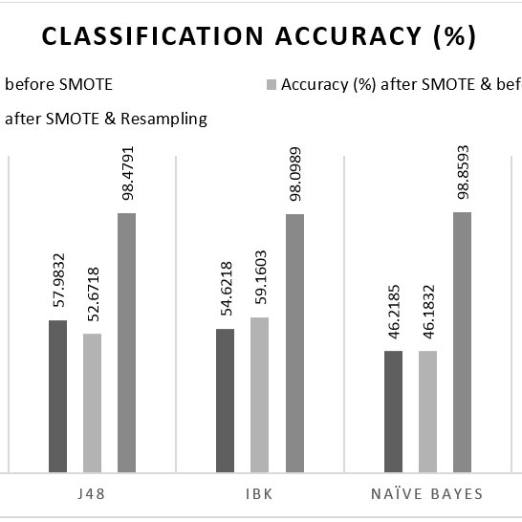

Slide 17
INNOVATION
Predicting IMDb scores involves analyzing various factors like user reviews, movie genre, cast, crew, and plot. Innovations in this area often come from advancements in machine learning and data analysis techniques. One innovative approach could involve utilizing deep learning algorithms, natural language processing, and sentiment analysis to extract insights from user reviews and social media discussions about the movie .Additionally, incorporating collaborative filtering techniques, where user preferences are used to make predictions based on similar users' behaviors, can enhance the accuracy of predictions. Integrating real-time data, such as social media trends and box office performance, can provide a more comprehensive view, leading to better predictions .Furthermore, leveraging explainable AI methods is crucial, as they provide insights into why a particular prediction was made, enhancing the transparency and trustworthiness of the model .Remember, the effectiveness of any prediction model depends on the quality and relevance of the data used for training and the algorithms employed for analysis.

